Slide 1
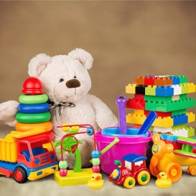
Mexico TOY Sales
Analysis of Maven Toys (Mexico) sales & inventory data
Using – MS Excel & Power BI
REKAA SELVARAJ
APRIL 2026

Slide 2
Mexico Toy Sales Dataset
Project Overview
This project analyzes Maven Toys sales and inventory data by integrating multiple sources into a structured data model.
It evaluates sales trends, demand patterns, inventory efficiency, and profitability to deliver insights for better decision-making.
Objectives
Analyze sales trends and growth over time.
Understand product demand and its impact on inventory.
Identify gaps between sales and available stock.
Evaluate store performance and identify top and underperforming stores.
Improve inventory usage and track stock movement.
Analyze profitability based on cost, price, and sales.
Identify patterns that influence sales and performance.

Slide 3
Data Sources
Source Description - https://mavenanalytics.io/data-playground/mexico-toy-sales
Timeline - 2022
Domain - Retail
Problem Statement
Maven Toys lacks a centralized analytics system to effectively track sales, product demand, store performance, and inventory across its operations.
This limitation makes it difficult to gain clear insights into business performance and identify key trends and issues.
This project addresses these challenges by building a structured data model that integrates and organizes the data for efficient analysis.
It also provides interactive dashboards to deliver meaningful insights and support better data-driven decision-making.

Slide 4
Attribute (Column /Features) Details
Attribute | Description | Business Meaning
Sale_ID | Unique identifier for each sales transaction | Used to track and differentiate every individual sale
Date | Date on which the sale occurred | Helps analyze sales trends over time
Store_ID | Unique identifier for each store | Used to evaluate store-level performance and link inventory/sales to specific locations
Store_Name | Name of the store | Helps in reporting and comparing store performance
Store_City | Location of the store | Enables regional and city-wise analysis
Store_Open_Date | Date when the store was opened | Helps analyze store growth and maturity
Product_ID | Unique identifier for each product | Used to uniquely identify and link products across sales, inventory, and product tables
Product_Name | Name of the product | Helps in identifying and reporting product-level performance
Product_Category | Category of the product | Used to analyze category-wise sales and trends
Product_Cost | Cost price of the product | Helps calculate total cost and profit
Product_Price | Selling price of the product | Determines revenue generated per unit
Units | Number of units sold | Indicates demand and sales volume
Stock_On_Hand | Available quantity of stock | Indicates current inventory level for sales planning

Slide 5
Tools & Technologies
Excel: Data cleaning, transformation, data validation and calculations.
Power BI: Data modelling, DAX calculations, data integration, advanced visualization, and interactive dashboard development.
Data Transformation Steps (Excel /Power Query)
Removed duplicate records to ensure data accuracy and consistency.
Renamed headers to meaningful and standardized names.
Removed unnecessary spaces and special characters (e.g., underscores) for better readability.
Corrected data types (Date, Decimal, Whole Number) for proper analysis.
Cleaned and formatted numeric fields (currency values converted to numbers).
Created a new Profit column based on Product cost and Product price.
Calculated Profit Margin and formatted it as a percentage.
Ensured no null or error values in critical columns.
Validated data integrity across all tables before modeling.
Data Model
Created a star schema data model with Sales as the fact table and Products, Stores, and Inventory as dimension tables, establishing one-to-many (1:*) relationships with single-direction filtering.

Slide 6
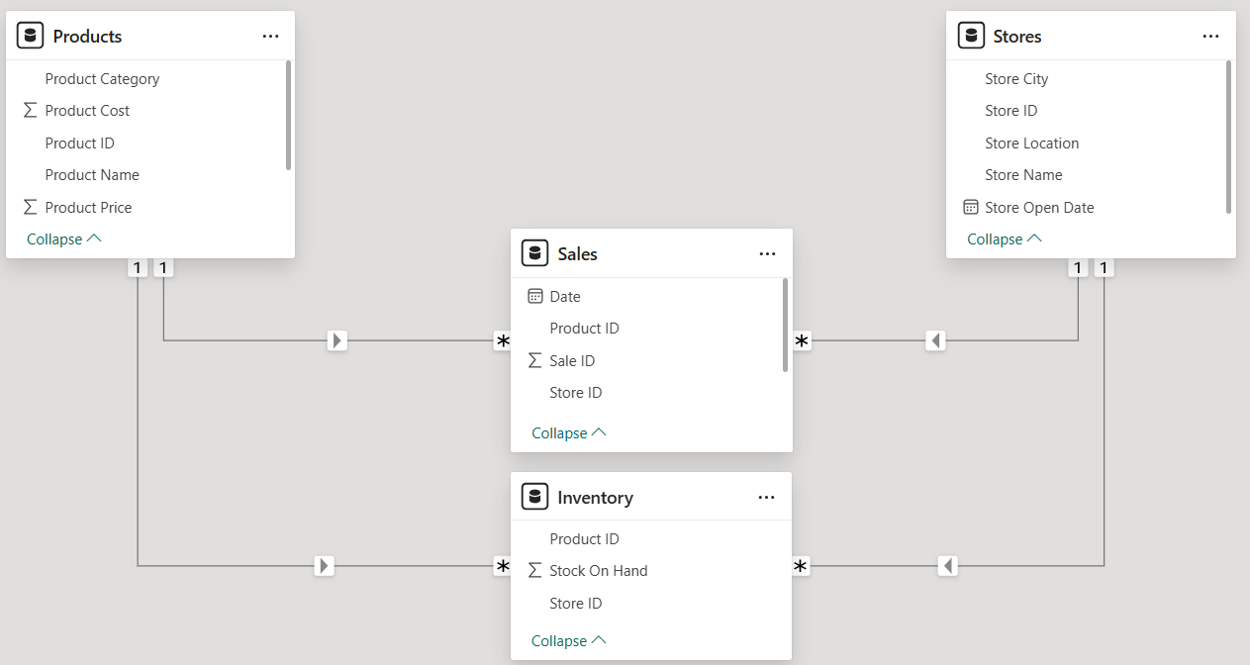
Data Modelling Screenshot

Slide 7
Calculated Columns
Created calculated columns for Profit and Profit Margin to evaluate business profitability and efficiency.
DAX Measures
Total Sales
Total Units
Profit
Profit Margin
MoM Growth
Total Stock
Growth Percentage
Sales Title
Store Title
Created a dynamic Calendar Table for performing time intelligence analysis

Slide 8
Analysis and Visualizations (Power BI)
KPI Cards: Used to present key business metrics such as Total Sales, Total Profit, Profit Margin, Units Sold, and MOM Growth for quick insights.
Bar Charts: Compared performance across different dimensions like cities, product categories, and stores.
Line Charts: Analyzed trends over time, including sales growth, profit, and unit sales.
Pie Charts: Visualized proportional distribution such as sales distribution and profit contribution.
Donut Charts: Visualized sales distribution across store locations.
Column/Stacked Column Chart: Shows month-wise total unit calculation and stacked column chart compares month-wise sales performance.
Tree Map: Visualized stock distribution by product, showing each product’s contribution to total stock levels.
Ribbon Chart: Analyzed stock level performance across product names and compare ranking changes.
Map Chart: Compared sales by store location to analyze geographical distribution of sales performance.

Slide 9
Analysis and Visualizations (Power BI) Cont.
Waterfall Chart: Analyzed profit contribution by product, showing how each product impacts overall profit.
Slicers : Enabled interactive filtering by date.
Gauge Chart: Created a comparison between actual sales and target sales using a manually set 10% target value.
Bookmark Creation : Created bookmarks to switch between All Products view and Top 5 Products view for dynamic analysis.
Buttons :Created interactive buttons for All Products and Top 5 Products to enable easy navigation between different views.
Top N Filter Setup : Applied Top N filtering logic to display only Top 5 performing products, while keeping an option to view all products.
Dynamic & Dual Title Setup : Created a DAX-based dynamic title and implemented dual titles using bookmarks to display either “All Products” or “Top 5 Products” based on user selection.

Slide 10
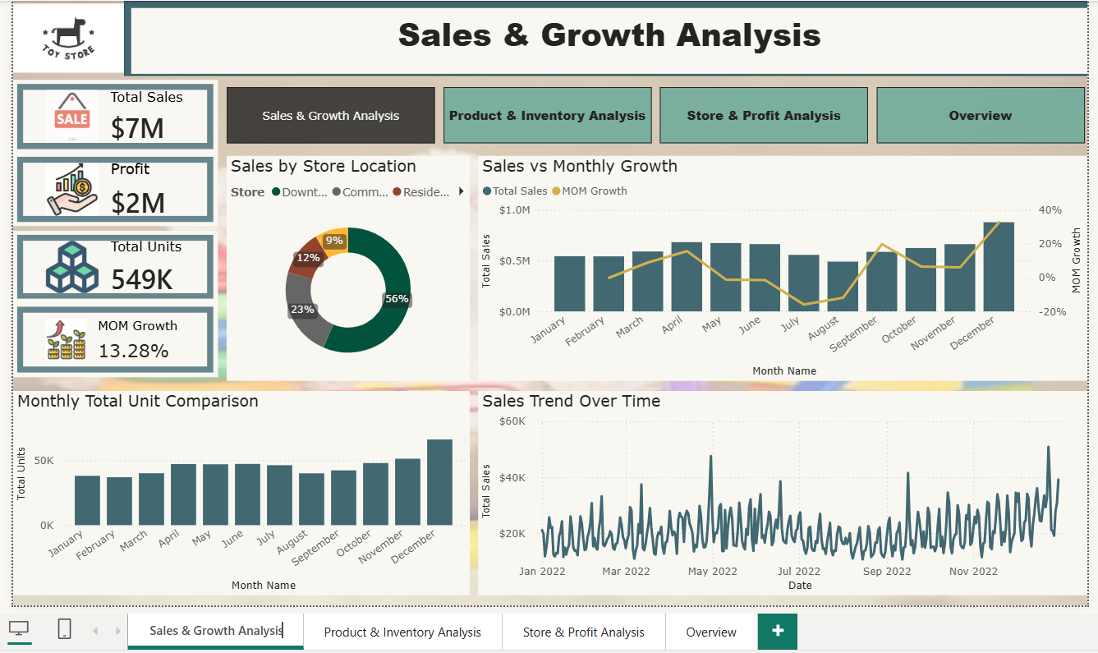

Slide 11
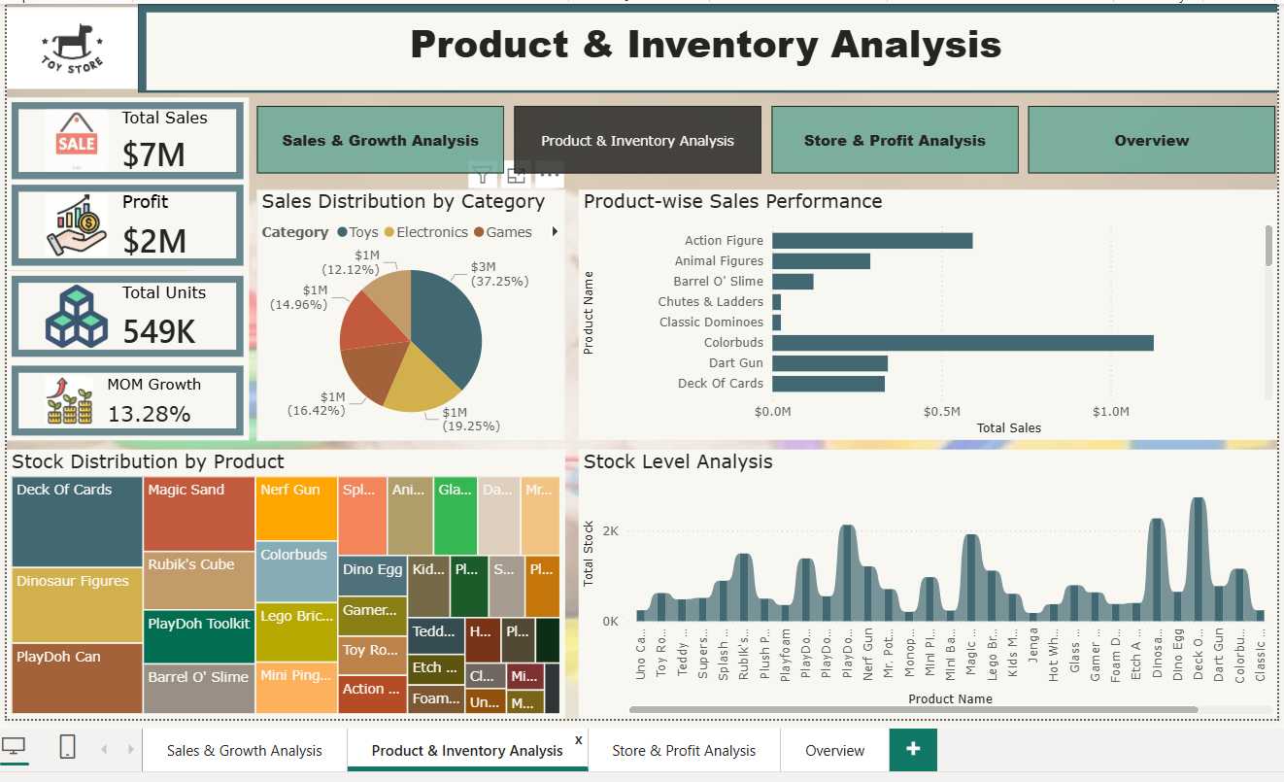

Slide 12
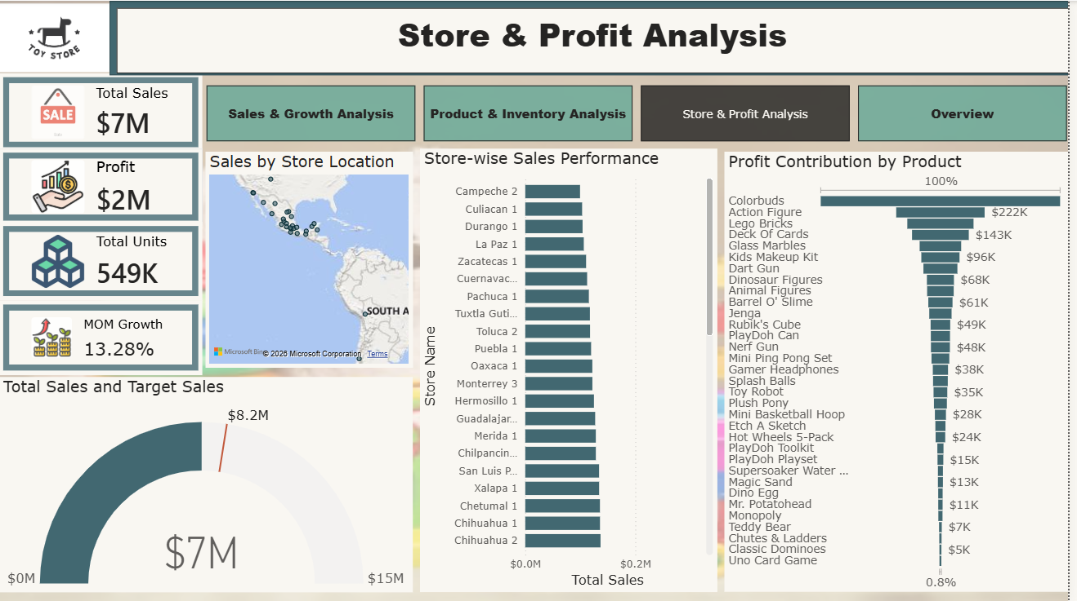

Slide 13
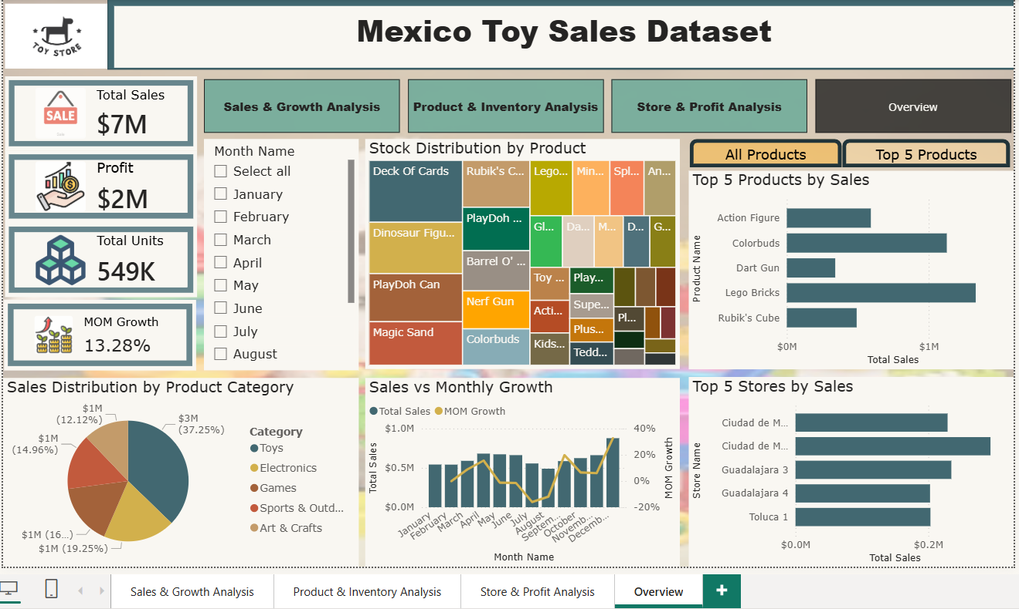

Slide 14
Insights
Descriptive Analytics
The business generated $7.48M in sales, 549K units sold, and $2.18M profit, indicating strong overall performance.
Lego Bricks $1.33M is the top-performing product, followed by Colorbuds, while Uno Card Game and Mr. Potato Head show the lowest sales.
Toys $2.78M and Electronics $1.44M dominate and contribute nearly 66% of total revenue. Ciudad de Mexico 2 $293K is the top-performing store, with other stores showing similar performance levels.
Sales peak in December $877K and drop in August $489K, showing clear seasonality. Inventory is uneven, with overstock in Deck Of Cards 2738 and understock in Jenga 181.
Diagnostic Analytics
Strong demand drives Lego Bricks $1.33M and Colorbuds, while Uno Card Game and Mr. Potato Head show weak demand.
Sales dependency is high on Toys $2.78M and Electronics $1.44M.
A $748K gap with 90.9% achievement indicates planning inefficiencies.
December peaks at $877K due to seasonal demand, while August drops to $489K with -11.98% showing slowdown.
Sales grow from $542K to $877K with 32.65% recovery after a slight dip to $541K with -0.22%, while inventory imbalance between Deck Of Cards 2738 and Jenga 181 highlights poor planning.

Slide 15
Predictive Analytics
Sales will likely rise in Q4, reaching around $0.88M.
Lego Bricks at $1.33M and Colorbuds will continue to lead sales.
Low-performing products are expected to remain weak.
Total sales may exceed $7.48M and approach $8.23M.
August-like dips around $0.49M may repeat.
A 13.28% MoM growth indicates continued expansion.
Inventory issues may cause stockouts for Jenga 181 and overstock for Deck Of Cards 2738.
Prescriptive Analytics
Focus on Lego Bricks $1.33M and Colorbuds with better stocking and promotion, while improving Uno Card Game and Mr. Potato Head through discounts or bundling.
Reduce reliance on Toys $2.78M and Electronics $1.44M to diversify revenue.
Close the $0.75M gap to achieve the $8.23M target.
Run campaigns to avoid sales drops around $0.49M and sustain growth from $0.54M to $0.88M.
Balance inventory by reducing Deck Of Cards 2738 and increasing Jenga 181 and Classic Dominoes 241

Slide 16
Conclusion
The business shows strong overall performance, achieving $7.48M sales, 549K units sold, and $2.18M profit, with steady growth momentum (13.28% MOM growth).
Sales performance is slightly below target, reaching 90.9% of the $8.23M goal, indicating a small but important revenue gap of $748K that needs improvement.
Product performance is uneven, where Lego Bricks leads significantly ($1.33M) while some products like Uno Card Game and Mr. Potato Head underperform, suggesting the need for product optimization.
Category analysis shows high dependency on Toys and Electronics, which together contribute nearly two-thirds of total revenue, highlighting limited diversification.
Store-level performance is fairly balanced, with Ciudad de Mexico 2 as the top-performing store ($293K), showing no extreme gaps but slight leadership from specific locations.
Sales trends indicate strong seasonality, with a peak in December ($877K) and a dip in August ($489K), showing clear Q4-driven demand patterns.
Overall, the business is growing steadily but depends heavily on a few key products, categories, and seasonal peaks, which creates both strength and risk.

